Slide 1
Chapter 3 - Data Modeling Using the Entity– Relationship (ER) Model

Slide 2
- Using High-Level Conceptual Data Models for Database Design - A Sample Database Application - Entity Types, Entity Sets, Attributes and Keys - Relationship Types, Relationship Sets, Roles, and Structural Constraints - Weak Entity Types - Refining the ER Design for the COMPANY Database - ER Diagrams, Naming Conventions, and Design Issues -Relationship Types of Degree Higher than Two
Content

Slide 3
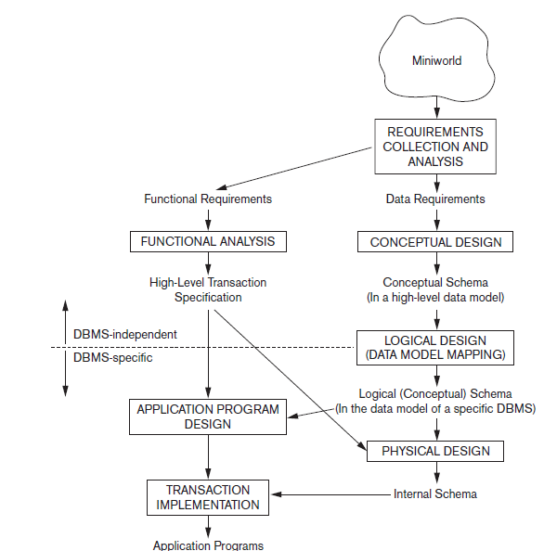
Using High-Level Conceptual Data Models for Database Design
Figure 3.1 shows a simplified overview of the database design process.
The first step is: Requirements collection and analysis.
The database designers interview prospective database users to understand and document their data requirements.
The result of this step is a concisely written set of users’ requirements.
a description of the data used;
the details of how data is to be used;
any additional requirements for the new database system.

Slide 4
Using High-Level Conceptual Data Models for Database Design
In parallel with specifying the data requirements, it is useful to specify the known functional requirements of the application.
User defined operations (or transactions) that will be applied to the database, including both retrievals and updates.
In software design, it is common to use data flow diagrams, sequence diagrams, scenarios, and other techniques to specify functional requirements.

Slide 5
Using High-Level Conceptual Data Models for Database Design
The next step is to create a conceptual schema for the database, using a high-level conceptual data model. This step is conceptual design.
The conceptual schema is a concise description of the data requirements of the users and includes detailed descriptions of the entity types, relationships, and constraints.
Because these concepts do not include implementation details, they are usually easier to understand and can be used to communicate with nontechnical users.

Slide 6
Using High-Level Conceptual Data Models for Database Design
Conceptual database design is entirely independent of implementation details such as the target DBMS software, application programs, programming languages, hardware platform, or any other physical considerations.
This approach enables database designers to concentrate on specifying the properties of the data, without being concerned with storage and implementation details, which makes it easier to create a good conceptual database design.

Slide 7
Using High-Level Conceptual Data Models for Database Design
The next step in database design is the actual implementation of the database, using a commercial DBMS.
Most current commercial DBMSs use an implementation data model—such as the relational (SQL) model—so the conceptual schema is transformed from the high-level data model into the implementation data model.
This step is called logical design or data model mapping;
its result is a database schema in the implementation data model of the DBMS.

Slide 8
Using High-Level Conceptual Data Models for Database Design
A logical model is derived knowing the underlying data model of the target DBMS. In other words, we know that the DBMS is, for example, relational or object-oriented.
However, we ignore any other aspects of the chosen DBMS and,in particular, any physical details, such as storage structures or indexes.

Slide 9
Using High-Level Conceptual Data Models for Database Design
The last step is the physical design phase, during which the internal storage structures, file organizations, indexes, access paths.
In general, the main aim of physical database design is to describe how we intend to physically implement the logical database design. For the relational model, this involves:
creating a set of relational tables and the constraints on these tables from the information presented in the logical data model.
identifying the specific storage structures and access methods for the data to achieve an optimum performance for the database system.

Slide 10
Using High-Level Conceptual Data Models for Database Design
In parallel with these activities, application programs are designed and implemented as database transactions corresponding to the high-level transaction specifications.

Slide 11
A Sample Database Application
We describe a sample database application, called COMPANY, which serves to illustrate the basic ER model concepts and their use in schema design.
We list the data requirements for the database here, and then create its conceptual schema step-by-step as we introduce the modeling concepts of the ER model.
The COMPANY database keeps track of a company’s employees, departments, and projects.

Slide 12
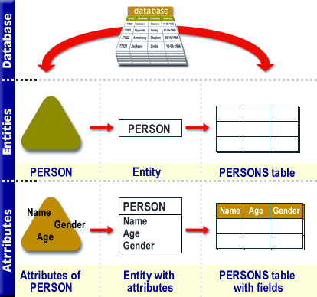
Entity Types, Entity Sets, Attributes, and Keys
Entities and Attributes
Entity: is a thing or object in the real world with an independent existence.
An entity may be an object with a physical existence (for example, a particular person, car, house, or employee)
or
it may be an object with a conceptual existence (for instance, a job, or a university course).
Attributes: the particular properties that describe it.
For example, an EMPLOYEE entity may be described by the employee’s name, age, address, salary, and job.

Slide 13
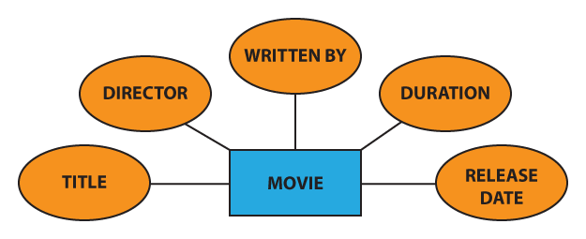
Entity Types, Entity Sets, Attributes, and Keys
Entities and Attributes
Representation in ER

Slide 14
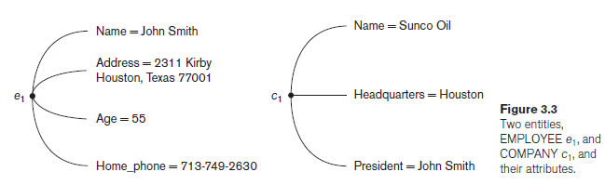
Entity Types, Entity Sets, Attributes, and Keys
Entities and Attributes
The EMPLOYEE entity e1 has four attributes: Name, Address, Age, and Home_phone; their values are ‘John Smith,’ ‘2311 Kirby, Houston, Texas 77001’, ‘55’, and ‘713-749-2630’, respectively.
The COMPANY entity c1 has three attributes: Name, Headquarters, and President; their values are ‘Sunco Oil’, ‘Houston’, and ‘John Smith’, respectively.
Several types of attributes occur in the ER model: simple versus composite, single valued versus multivalued, and stored versus derived.

Slide 15
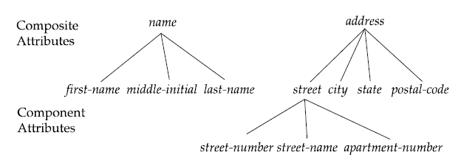
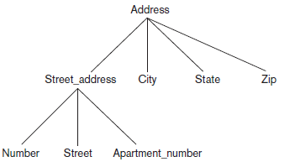
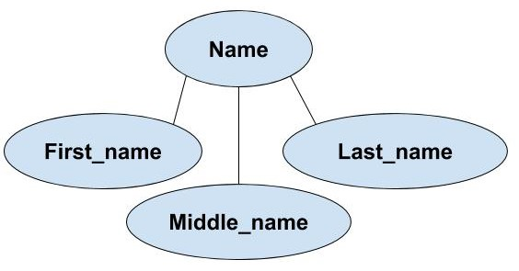
Entity Types, Entity Sets, Attributes, and Keys
Entities and Attributes
Composite versus Simple (Atomic) Attributes
Composite attributes can be divided into smaller subparts, which represent more basic attributes with independent meanings.
Composite attributes can form a hierarchy:
for example, Street_address can be further subdivided into three simple component attributes: Number, Street, and Apartment_number, as shown in Figure 3.4.
The value of a composite attribute is the concatenation of the values of its component simple attributes.

Slide 16
Entity Types, Entity Sets, Attributes, and Keys
Entities and Attributes
Composite versus Simple (Atomic) Attributes
For example, the Address attribute of the EMPLOYEE entity shown in Figure 3.3 can be subdivided into Street_address, City, State, and Zip,3 with the values ‘2311 Kirby’, ‘Houston’, ‘Texas’, and ‘77001’.
Attributes that are not divisible are called simple or atomic attributes.

Slide 17
Entity Types, Entity Sets, Attributes, and Keys
Entities and Attributes
Composite versus Simple (Atomic) Attributes
Where are Composite attributes used?
Useful to model situations in which a user sometimes refers to the composite attribute as a unit but at other times refers specifically to its components.
If the composite attribute is referenced only as a whole, there is no need to subdivide it into component attributes.
For example, if there is no need to refer to the individual components of an address (Zip Code, street, and so on), then the whole address can be designated as a simple attribute.

Slide 18
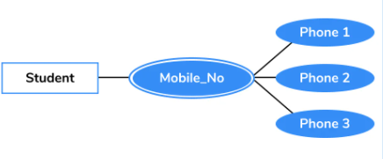
Entity Types, Entity Sets, Attributes, and Keys
Entities and Attributes
Single-Valued versus Multivalued Attributes.
Single-valued: Attributes have a single value for a particular entity.
For example, Age is a single-valued attribute of a person.
An attribute can have a set of values for the same entity—for instance, a Colors attribute for a car, or a College_degrees attribute for a person.
Cars with one color have a single value, whereas two-tone cars have two color values.

Slide 19
Entity Types, Entity Sets, Attributes, and Keys
Entities and Attributes
Single-Valued versus Multivalued Attributes.
Multivalued: Similarly, one person may not have any college degrees, another person may have one, and a third person may have two or more degrees; therefore, different people can have different numbers of values for the College_degrees attribute.
A multivalued attribute may have lower and upper bounds to constrain the number of values allowed for each individual entity.
For example, the Colors attribute of a car may be restricted to have between one and two values, if we assume that a car can have two colors at most.

Slide 20
Entity Types, Entity Sets, Attributes, and Keys
Entities and Attributes
Stored versus Derived Attributes
In some cases, two (or more) attribute values are related—for example, the Age and Birth_date attributes of a person.
For a particular person entity, the value of Age can be determined from the current (today’s) date and the value of that person’s Birth_date.
The Age attribute is hence called a derived attribute and is said to be derivable from the Birth_date attribute, which is called a stored attribute.
Some attribute values can be derived from related entities; for example, an attribute Number_of_employees of a DEPARTMENT entity can be derived by counting the number of employees related to (working for) that department.

Slide 21
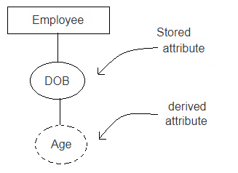
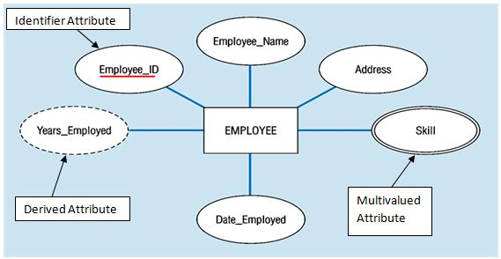
Entity Types, Entity Sets, Attributes, and Keys
Entities and Attributes
Stored versus Derived Attributes

Slide 22
Entity Types, Entity Sets, Attributes, and Keys
Entities and Attributes
NULL Values.
In some cases, a particular entity may not have an applicable value for an attribute.
For example: Apartment_number attribute of an address applies only to addresses that are in apartment buildings and not to other types of residences, such as single-family homes.
Similarly, a College_degrees attribute applies only to people with college degrees.
For such situations, a special value called NULL is created.

Slide 23
Entity Types, Entity Sets, Attributes, and Keys
Entities and Attributes
NULL Values.
An address of a single-family home would have NULL for its Apartment_number attribute, and a person with no college degree would have NULL for College_degrees.
NULL can also be used if we do not know the value of an attribute for a particular entity—for example, if we do not know the home phone number of ‘John Smith’ .
The meaning of the former type of NULL is not applicable, whereas the meaning of the latter is unknown.
The unknown category of NULL can be further classified into two cases.
The first case arises when it is known that the attribute value exists but is missing—for instance, if the Height attribute of a person is listed as NULL.
The second case arises when it is not known whether the attribute value exists—for example, if the Home_phone attribute of a person is NULL.

Slide 24

Entity Types, Entity Sets, Attributes, and Keys
Entities and Attributes
Complex Attributes
Composite and multivalued attributes can be nested.
Complex Attributes: We can represent nesting by grouping components of a composite attribute between parentheses ( ) and separating the components with commas, and by displaying multivalued attributes between braces { }.
For example, if a person can have more than one residence and each residence can have a single address and multiple phones, an attribute Address_phone for a person can be specified as shown in Figure 3.5.4 Both Phone and Address are themselves composite attributes.

Slide 25
Entity Types, Entity Sets, Attributes, and Keys
Entity Types, Entity Sets, Keys, and Value Sets
Entity Types and Entity Sets
A database usually contains groups of entities that are similar.
For example, a company employing hundreds of employees may want to store similar information concerning each of the employees.
These employee entities share the same attributes, but each entity has its own value(s) for each attribute.
Entity type: Defines a collection (or set) of entities that have the same attributes. Each entity type in the database is described by its name and attributes.
Figure 3.6 shows two entity types: EMPLOYEE and COMPANY, and a list of some of the attributes for each. A few individual entities of each type are also illustrated, along with the values of their attributes.

Slide 26
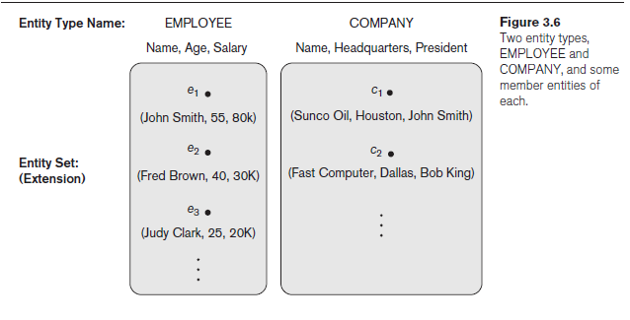
Entity Types, Entity Sets, Attributes, and Keys
Entity Types, Entity Sets, Keys, and Value Sets
Entity Types and Entity Sets

Slide 27
Entity Types, Entity Sets, Attributes, and Keys
Entity Types, Entity Sets, Keys, and Value Sets
Entity Types and Entity Sets
The collection of all entities of a particular entity type in the database at any point in time is called an entity set or entity collection is usually referred to using the same name as the entity type, even though they are two separate concepts.
For example, EMPLOYEE refers to both a type of entity as well as the current collection of all employee entities in the database.
An entity type is represented in ER as a rectangular box enclosing the entity type name.
Attribute names are enclosed in ovals and are attached to their entity type by straight lines.

Slide 28
Entity Types, Entity Sets, Attributes, and Keys
Entity Types, Entity Sets, Keys, and Value Sets
Entity Types and Entity Sets
Composite attributes are attached to their component attributes by straight lines.
Multivalued attributes are displayed in double ovals.
An entity type describes the schema or intension for a set of entities that share the same structure.
The collection of entities of a particular entity type is grouped into an entity set, which is also called the extension of the entity type.

Slide 29
Entity Types, Entity Sets, Attributes, and Keys
Entity Types, Entity Sets, Keys, and Value Sets
Key Attributes of an Entity Type
An important constraint on the entities of an entity type is the key or uniqueness constraint on attributes.
An entity type usually has one or more attributes whose values are distinct for each individual entity in the entity set. Such an attribute is called a key attribute, and its values can be used to identify each entity uniquely.
For example, the Name attribute is a key of the COMPANY entity type in Figure 3.6 because no two companies are allowed to have the same name.
For the PERSON entity type, a typical key attribute is Ssn (Social Security number).

Slide 30
Entity Types, Entity Sets, Attributes, and Keys
Entity Types, Entity Sets, Keys, and Value Sets
Key Attributes of an Entity Type
Sometimes several attributes together form a key, meaning that the combination of the attribute values must be distinct for each entity.
If a set of attributes possesses this property, the proper way to represent this in the ER model that we describe here is to define a composite attribute and designate it as a key attribute of the entity type.

Slide 31
Entity Types, Entity Sets, Attributes, and Keys
Entity Types, Entity Sets, Keys, and Value Sets
Key Attributes of an Entity Type
In ER diagrammatic notation, each key attribute has its name underlined inside the oval.
Hence, it is a constraint that prohibits any two entities from having the same value for the key attribute at the same time.
Some entity types have more than one key attribute. For example, each of the Vehicle_id and Registration attributes of the entity type CAR (Figure 3.7) is a key in its own right.
The Registration attribute is an example of a composite key formed from two simple component attributes, State and Number, neither of which is a key on its own.
An entity type may also have no key, in which case it is called a weak entity type
In our diagrammatic notation, if two attributes are underlined separately, then each is a key on its own.

Slide 32
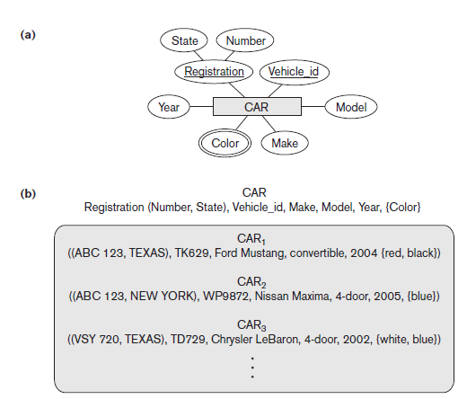
Entity Types, Entity Sets, Attributes, and Keys
Entity Types, Entity Sets, Keys, and Value Sets
Key Attributes of an Entity Type

Slide 33
Entity Types, Entity Sets, Attributes, and Keys
Initial Conceptual Design of the COMPANY Database
We can now define the entity types for the COMPANY database, based on the requirements.
1. An entity type DEPARTMENT with attributes:
Name, Number, Locations, Manager, and Manager_start_date.
Locations is the only multivalued attribute.
We can specify that both Name and Number are (separate) key attributes because each was specified to be unique.
2. An entity type PROJECT with attributes:
Name, Number, Location, and Controlling_department.
Both Name and Number are (separate) key attributes.

Slide 34
Entity Types, Entity Sets, Attributes, and Keys
Initial Conceptual Design of the COMPANY Database
We can now define the entity types for the COMPANY database, based on the requirements.
3. An entity type EMPLOYEE with attributes:
Name, Ssn, Sex, Address, Salary, Birth_date, Department, and Supervisor.
Both Name and Address may be composite attributes.
In our example, Name is modeled as a composite attribute, whereas Address is not, presumably after consultation with the users.
4. An entity type DEPENDENT with attributes
Employee, Dependent_name, Sex, Birth_date, and Relationship (to the employee).

Slide 35
Entity Types, Entity Sets, Attributes, and Keys
Initial Conceptual Design of the COMPANY Database
Another requirement is that: an employee can work on several projects, and the database has to store the number of hours per week an employee works on each project.
It can be represented by a multivalued composite attribute of EMPLOYEE called Works_on with the simple components (Project, Hours).
Alternatively, it can be represented as a multivalued composite attribute of PROJECT called Workers with the simple components (Employee, Hours).

Slide 36
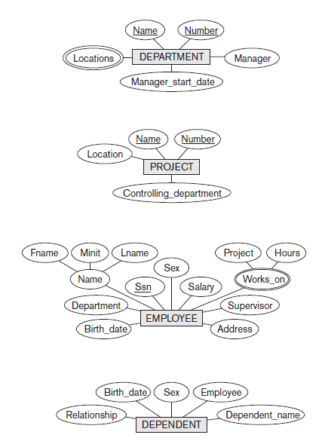
Entity Types, Entity Sets, Attributes, and Keys
Initial Conceptual Design of the COMPANY Database

Slide 37
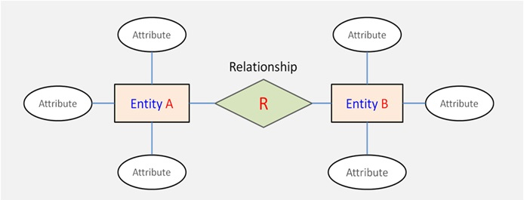
Relationship Types, Relationship Sets, Roles, and Structural Constraints
Relationship Types, Sets, and Instances
A relationship type R among n entity types E1, E2, . . . , En defines a set of associations— or a relationship set—among entities from these entity types.
Each of the entity types E1, E2, . . . , En is said to participate in the relationship type R.

Slide 38
Relationship Types, Relationship Sets, Roles, and Structural Constraints
Relationship Types, Sets, and Instances
For example:
Consider a relationship type WORKS_FOR between the two entity types EMPLOYEE and DEPARTMENT, which associates each employee with the department for which the employee works.
Each relationship instance in the relationship set WORKS_FOR associates one EMPLOYEE entity and one DEPARTMENT entity.
In the miniworld represented by Figure 3.9, the employees e1, e3, and e6 work for department d1; the employees e2 and e4 work for department d2; and the employees e5 and e7 work for department d3.

Slide 39
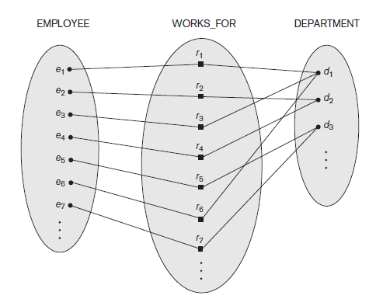
Relationship Types, Relationship Sets, Roles, and Structural Constraints
Relationship Types, Sets, and Instances
In ER diagrams, relationship types are displayed as diamond-shaped boxes, which are connected by straight lines to the rectangular boxes representing the participating entity types.
The relationship name is displayed in the diamond-shaped box.

Slide 40
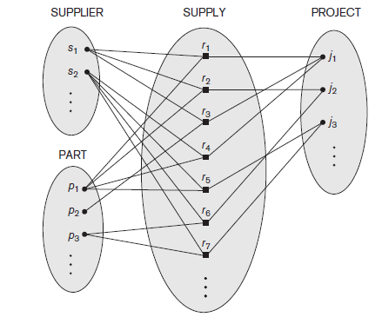
Relationship Types, Relationship Sets, Roles, and Structural Constraints
Relationship Degree, Role Names, and Recursive Relationships
Degree of a Relationship Type
The degree of a relationship type is the number of participating entity types. Hence, the WORKS_FOR relationship is of degree two.
A relationship type of degree two is called binary, and one of degree three is called ternary.
An example of a ternary relationship is SUPPLY, shown in Figure 3.10, where each relationship instance ri associates three entities—a supplier s, a part p, and a project j—whenever s supplies part p to project j.

Slide 41
Relationship Types, Relationship Sets, Roles, and Structural Constraints
Relationship Degree, Role Names, and Recursive Relationships
Role Names and Recursive Relationships
Each entity type that participates in a relationship type plays a particular role in the relationship.
The role name signifies the role that a participating entity from the entity type plays in each relationship instance, and it helps to explain what the relationship means.
For example, in the WORKS_FOR relationship type, EMPLOYEE plays the role of employee or worker and DEPARTMENT plays the role of department or employer.

Slide 42
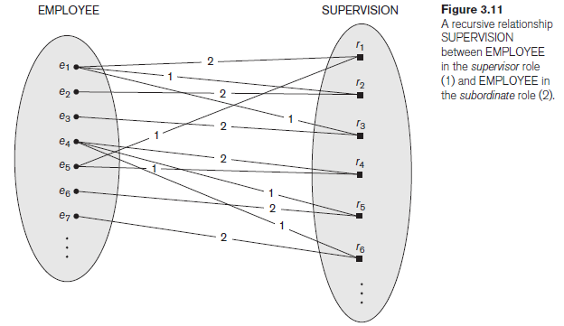
Relationship Types, Relationship Sets, Roles, and Structural Constraints
Relationship Degree, Role Names, and Recursive Relationships
Role Names and Recursive Relationships
In some cases the same entity type participates more than once in a relationship type in different roles.
In such cases the role name becomes essential for distinguishing the meaning of the role that each participating entity plays. Such relationship types are called recursive relationships or self-referencing relationships.
The SUPERVISION relationship type relates an employee to a supervisor, where both employee and supervisor entities are members of the same EMPLOYEE entity set. Hence, the EMPLOYEE entity type participates twice in SUPERVISION: once in the role of supervisor (or boss), and once in the role of supervisee (or subordinate).

Slide 43
Relationship Types, Relationship Sets, Roles, and Structural Constraints
Relationship Degree, Role Names, and Recursive Relationships
Role Names and Recursive Relationships
In Figure 3.11, the lines marked ‘1’ represent the supervisor role, and those marked ‘2’ represent the supervisee role; hence, e1 supervises e2 and e3, e4 supervises e6 and e7, and e5 supervises e1 and e4.
In this example, each relationship instance must be connected with two lines, one marked with ‘1’ (supervisor) and the other with ‘2’ (supervisee).

Slide 44
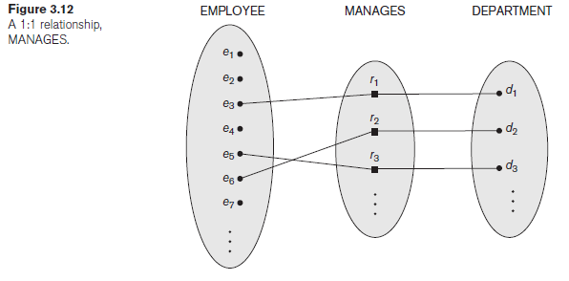
Relationship Types, Relationship Sets, Roles, and Structural Constraints
Constraints on Binary Relationship Types
Cardinality Ratios for Binary Relationships
The cardinality ratio for a binary relationship specifies the maximum number of relationship instances that an entity can participate in.
For example, in the WORKS_FOR binary relationship type, DEPARTMENT:EMPLOYEE is of cardinality ratio 1:N, meaning that each department can be related to (that is, employs) any number of employees (N), but an employee can be related to (work for) at most one department.
This means that for this particular relationship type WORKS_FOR, a particular department entity can be related to any number of employees (N indicates there is no maximum number).

Slide 45
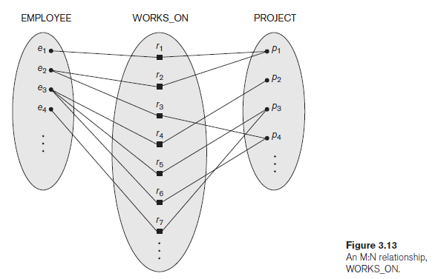
Relationship Types, Relationship Sets, Roles, and Structural Constraints
Constraints on Binary Relationship Types
Cardinality Ratios for Binary Relationships
On the other hand, an employee can be related to a maximum of one department.
The possible cardinality ratios for binary relationship types are 1:1, 1:N, N:1, and M:N.
An example of a 1:1 binary relationship is MANAGES (Figure 3.12), which relates a department entity to the employee who manages that department. This represents the miniworld constraints that—at any point in time—an employee can manage at most one department and a department can have at most one manager.
The relationship type WORKS_ON (Figure 3.13) is of cardinality ratio M:N, because the miniworld rule is that an employee can work on several projects and a project can have several employees.

Slide 46
Relationship Types, Relationship Sets, Roles, and Structural Constraints
Constraints on Binary Relationship Types
Participation Constraints and Existence Dependencies
The participation constraint specifies whether the existence of an entity depends on its being related to another entity via the relationship type.
This constraint specifies the minimum number of relationship instances that each entity can participate in and is sometimes called the minimum cardinality constraint.
There are two types of participation constraints—total and partial.

Slide 47
Relationship Types, Relationship Sets, Roles, and Structural Constraints
Constraints on Binary Relationship Types
Participation Constraints and Existence Dependencies
If a company policy states that every employee must work for a department, then an employee entity can exist only if it participates in at least one WORKS_FOR relationship instance.
Thus, the participation of EMPLOYEE in WORKS_FOR is called total participation, meaning that every entity in the total set of employee entities must be related to a department entity via WORKS_FOR.

Slide 48
Relationship Types, Relationship Sets, Roles, and Structural Constraints
Constraints on Binary Relationship Types
Participation Constraints and Existence Dependencies
Total participation is also called existence dependency.
In Figure 3.12 we do not expect every employee to manage a department, so the participation of EMPLOYEE in the MANAGES relationship type is partial, meaning that some or part of the set of employee entities are related to some department entity via MANAGES, but not necessarily all.
We will refer to the cardinality ratio and participation constraints, taken together, as the structural constraints of a relationship type.
In ER diagrams, total participation (or existence dependency) is displayed as a double line connecting the participating entity type to the relationship, whereas partial participation is represented by a single line.

Slide 49
Relationship Types, Relationship Sets, Roles, and Structural Constraints
Constraints on Binary Relationship Types
Attributes of Relationship Types
Relationship types can also have attributes, similar to those of entity types.
For example, to record the number of hours per week that a particular employee works on a particular project, we can include an attribute Hours for the WORKS_ON relationship type in Figure 3.13.
Another example is to include the date on which a manager started managing a department via an attribute Start_date for the MANAGES relationship type in Figure 3.12.

